Slide 1

FIN6120
Scoring Card Construction
Group4

Slide 2

2
GLMM Model
2

Slide 3
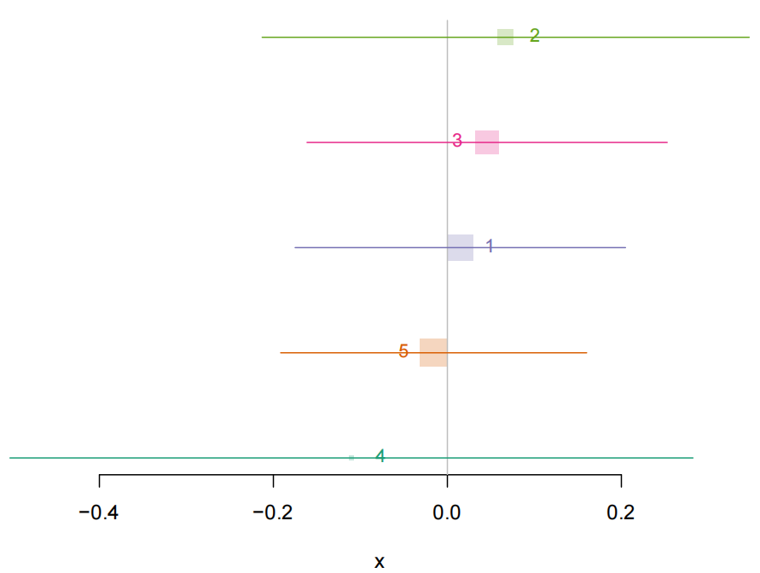
GLMM model 1
With all available parameters:
Account Balance,
Payment Status of Previous Credit,
Value Savings/Stocks,
Length of current employment,
Instalment per cent,
Sex & Marital Status,
Most valuable available asset, Concurrent Credits,
Foreign Worker,
Duration of credit(month),
Age(years)
Logistic Model
GLMM Model
Decision Tree
Ridge and Lasso
3

Slide 4
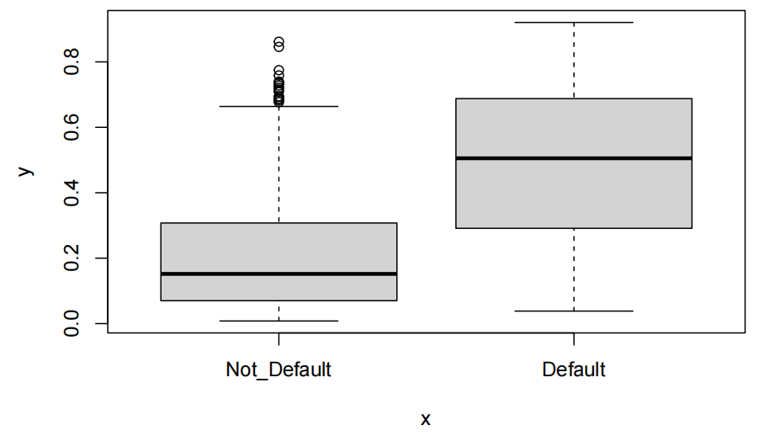
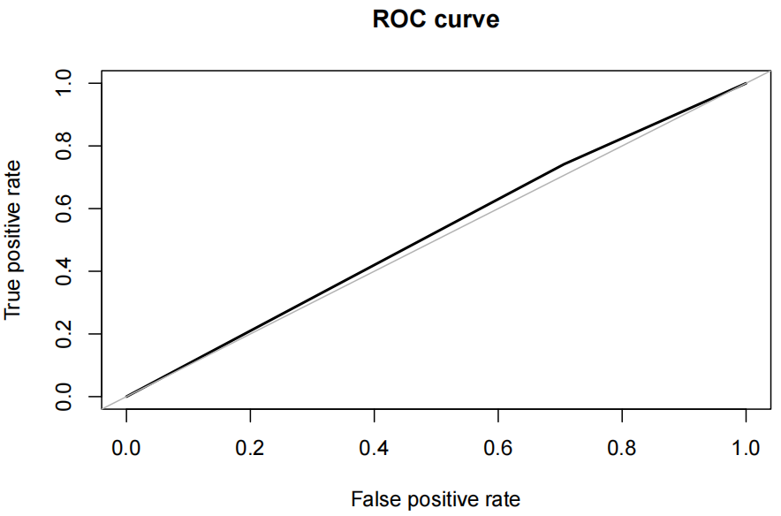

GLMM model 1
Area under the curve (AUC): 0.518
Logistic Model
GLMM Model
Decision Tree
Ridge and Lasso
4

Slide 5
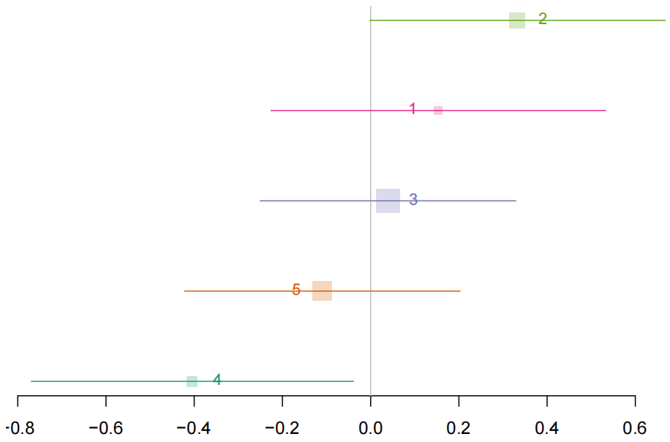
GLMM model 2
With 3 available parameters:
Value Savings/Stocks,
Duration of credit(month),
Age(years)
Except for Age, all other parameters are grouped dummy variables.
Logistic Model
GLMM Model
Decision Tree
Ridge and Lasso
5

Slide 6
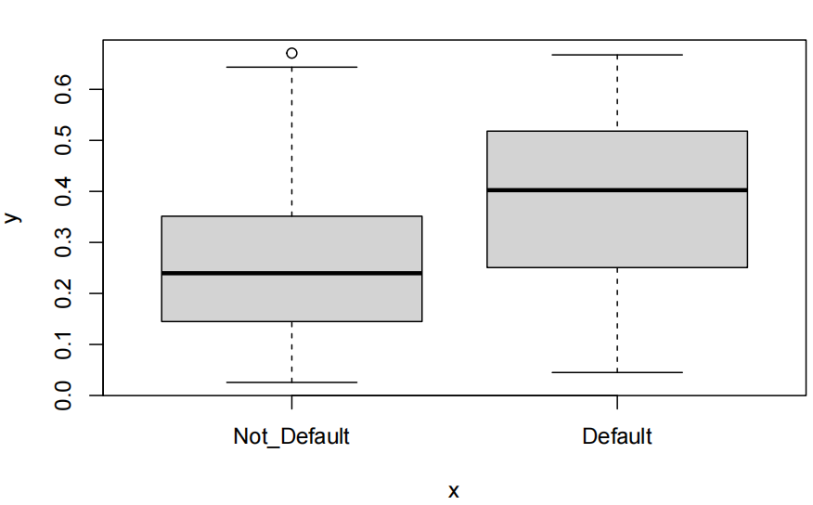
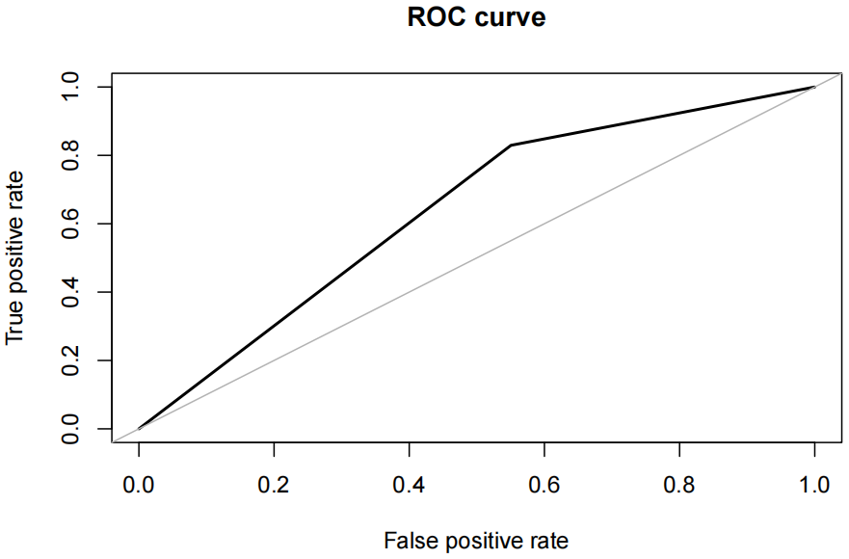

GLMM model 2
Area under the curve (AUC): 0.639
Logistic Model
GLMM Model
Decision Tree
Ridge and Lasso
6

Slide 7
3
Decision Tree Model
7

Slide 8
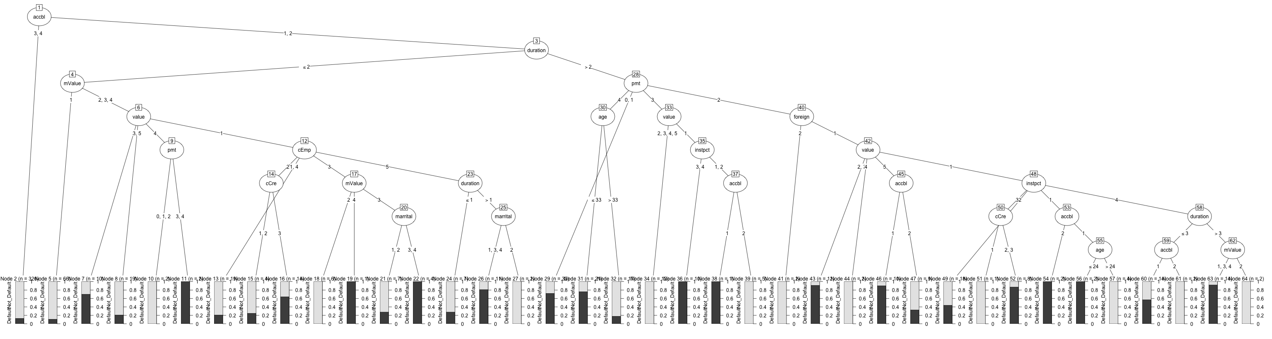
Decision Tree model 1
All 11 selected Model
Except for Age, all other parameters are grouped dummy variables.
Logistic Model
GLMM Model
Decision Tree
Ridge and Lasso
8

Slide 9
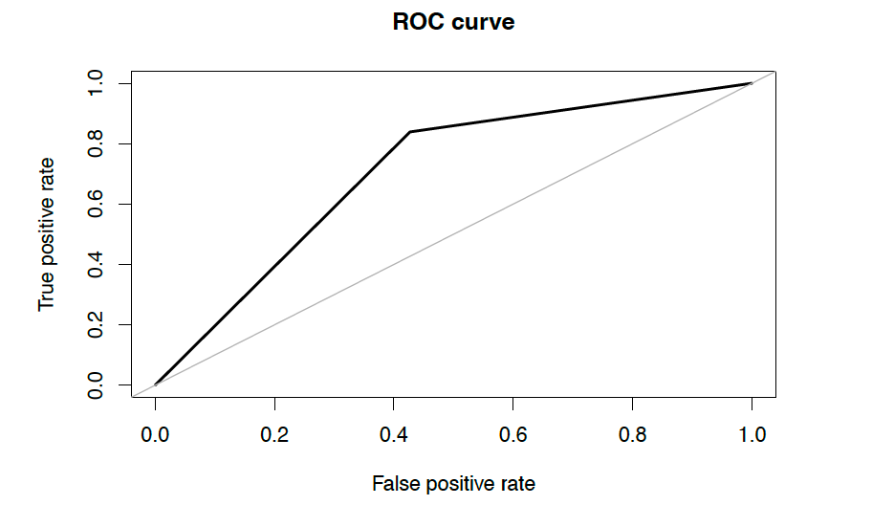
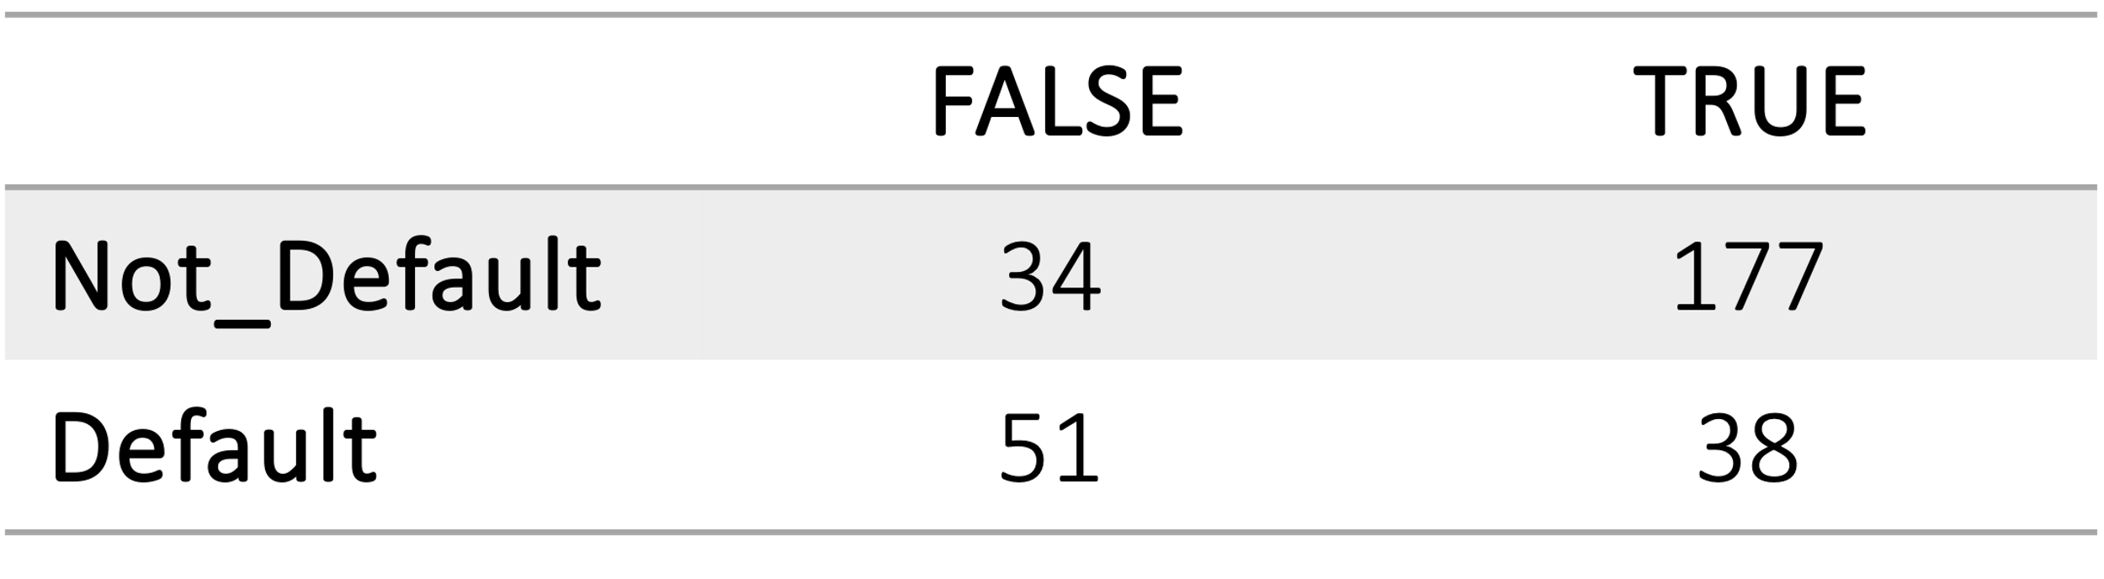
Decision Tree model 1
Area under the curve (AUC): 0.706
Better prediction for not_default clients
Logistic Model
GLMM Model
Decision Tree
Ridge and Lasso
9

Slide 10
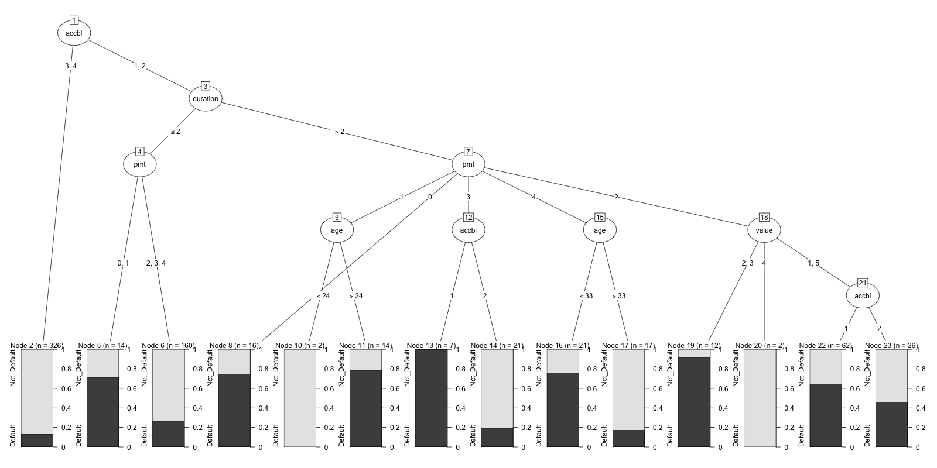
Decision Tree model 2
Selected parameters:
Account Balance,
Duration of credit(month),
Value Saving/Stocks,
Payment Status of Previous Credit,
Age(years)
Except for Age, all other parameters are grouped dummy variables.
Logistic Model
GLMM Model
Decision Tree
Ridge and Lasso
10

Slide 11
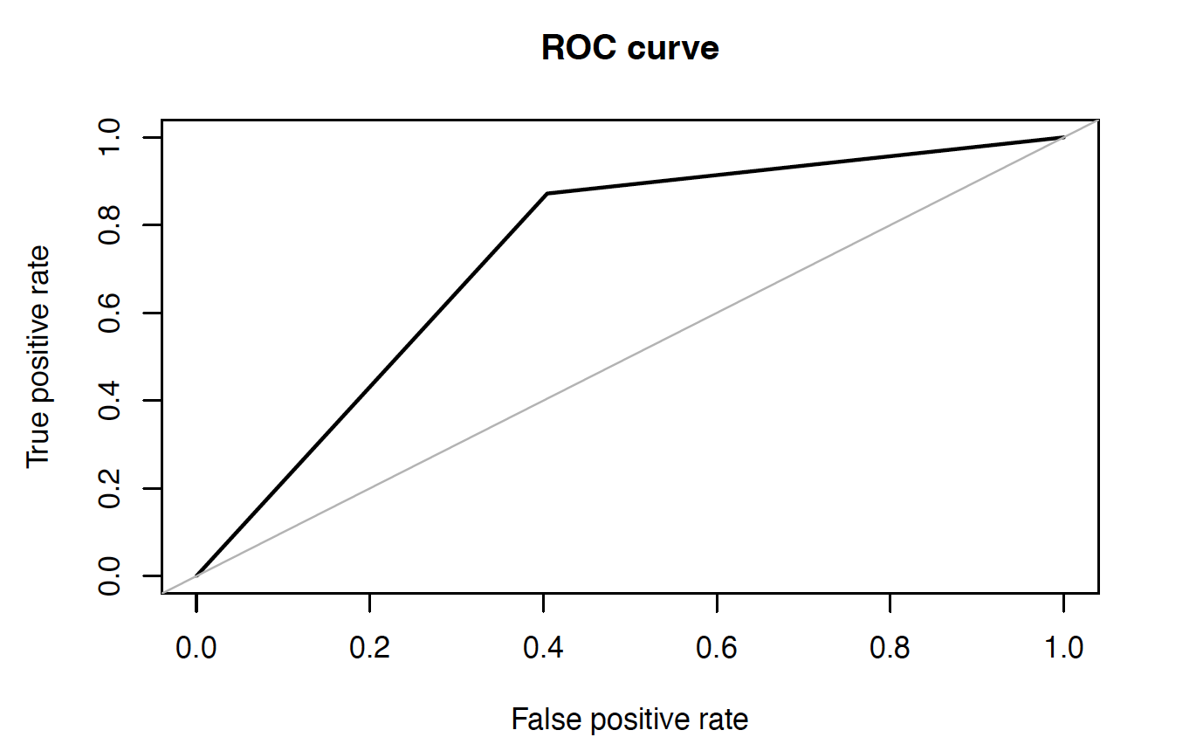
Decision Tree model 2
Area under the curve (AUC): 0.734
Perform better by better prediction on not-default client
Logistic Model
GLMM Model
Decision Tree
Ridge and Lasso
11

Slide 12
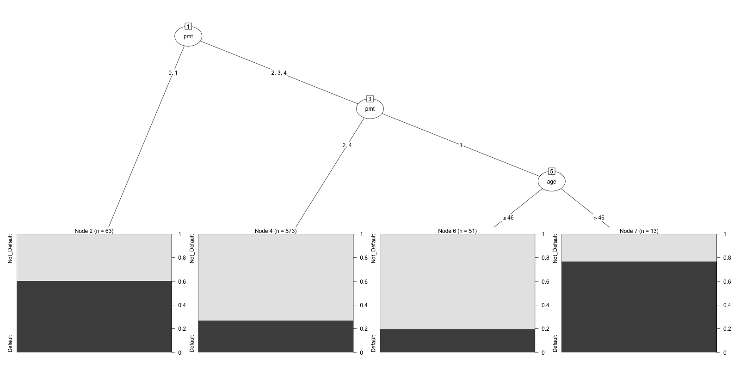
Decision Tree model 3
Selected parameters:
Sex and Marrital Status,
Value Saving/Stocks,
Payment Status of Previous Credit,
Age(years)
Except for Age, all other parameters are grouped dummy variables.
Logistic Model
GLMM Model
Decision Tree
Ridge and Lasso
12

Slide 13
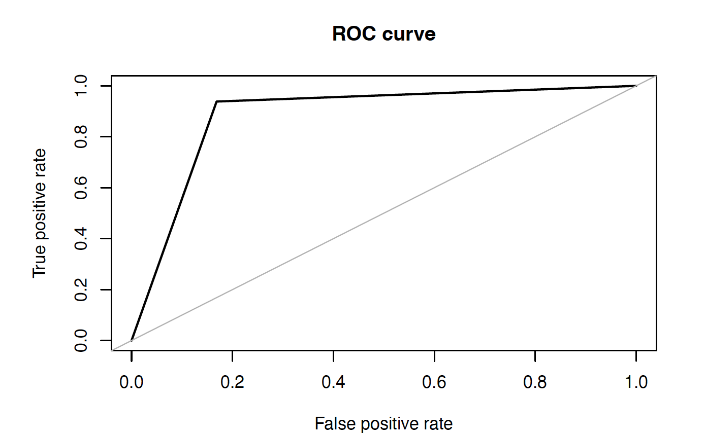
Decision Tree model 3
Area under the curve (AUC): 0.885
Perform better by significant increase in the correct prediction on not-default client
As a trade of the prediction on default client fail
However, we can still found default client by correctly selecting not-default client
Model 1
Model 2
Model 3
Model Comparison
13

Slide 14
Comparison of Decision Tree Models
70.6%
73.4%
88.5%
Model Conclusion
Sometimes, less is more. Due to time and coding skill restriction, our model can be fixed further with model combinations.
Logistic Model
GLMM Model
Decision Tree
Ridge and Lasso
14

Slide 15
4
Further Studies on parameter selection
15

Slide 16
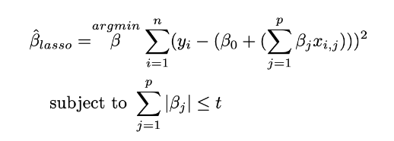
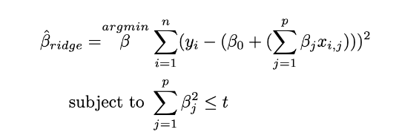
The Ridge and Lasso regression for parameter selection
Recommend R package: library(glmmLasso)
Logistic Model
GLMM Model
Decision Tree
Ridge and Lasso
16

Slide 17
FIN6120
GroupMembers:
Yuwei WANG, Yongxuan ZHU,
Zhen, LI, Haoyue TAN
THANK
YOU
Credit Scoring Card

